Slide 1
Kalman filter

Slide 2
An autonomous vehicle consists of various device through which it collects data and perform an action .
Data used by the Kalman filter comes from LIDAR and RADAR .
We can use Kalman Filter to make an educated guess , about what the system is going to do next in any place where we have uncertain information about some dynamic system .
In case of Autonomous Vehicle Kalman Filter can be used to predict the next set of actions that the car in-front of our autonomous vehicle is going to take based upon the data our vehicle receives .
It is an iterative process that uses two step predict and update.

Slide 3
It is mostly suitable for these type of operations because of the following factors :
It predict the next state based on the previous state only , no need of the history of data
very fast making it well suitable for real time problems.
Even if lots of noise/error/uncertainty occurs in the environment, Kalman filter will give a good result

Slide 4
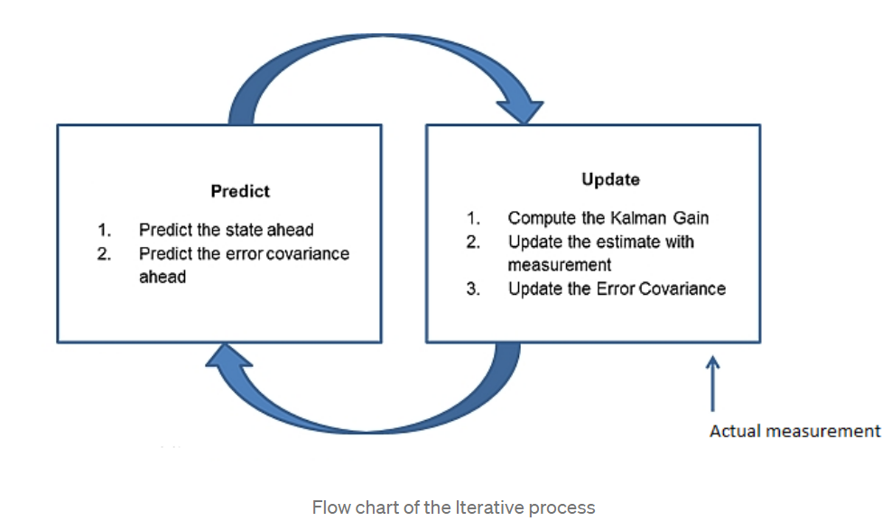
Kalman Filter is an iterative process that follows two step predict and update

Slide 5
Predict :
In this step the Kalman Filter predict the new values from the initial value and then predict the uncertainity/error/variance in our prediction according to the various process noise present in the system.
In autonomous vehicle process noise can be understood by taking a simple example of a car moving infront of our vehicle.
Our model will assume the car to move with a constant velocity due to zero acceleration, but it will have acceleration i.e. its speed will fluctuate from time to time.
This change in acceleration of that car is the uncertainity/error/variance and we introduce it to our system using process noise.

Slide 6
Update :
In this step we take the actual measured value from the devices of the system .
In case of autonomous vehicle these devices can be radar or Lidar .
We then calculate the difference between the predicted value and the measured value and then decide which value to keep i.e predicted value or measured value by calculating the Kalman Gain.
Based upon the decision made by the kalman gain we calculate the new value and new uncertainty/error/variance .
This output from the update step is again fed back to the prediction step and the process continues till the difference between the predicted value and the measured value tend to convert to zero.
This calculated value will be the prediction/educated guess done by the Kalman Filter.

Slide 7
Kalman Gain :
It determines whether our predicted or measured value is close to the actual value . Its value ranges from 0 to 1 .
If its value is near to 0 then it means predicted value is close to the actual value or if the value is near to 1 then it means final measured value is close to the actual value. Its value ranges from 0 to 1 because it uses the uncertainity/errors in the predicted and the measured value and is represented by the simple formula as show below.
K = Error In Prediction / (Error in Prediction + Error in Measurement)

Slide 8
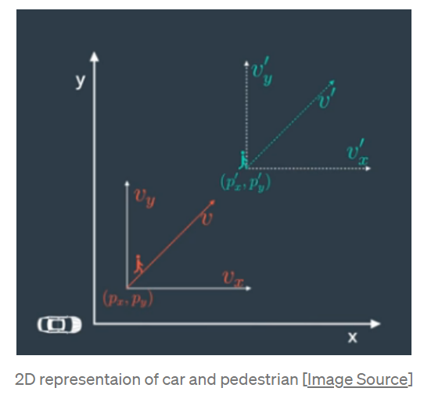
Implementation of Kalman Filter in Self Driving Car
Lets assume a 2D environment in which we have a car and a pedestrian moving by as shown below:

Slide 9
p_x and p_y determine the 2D position and v_x and v_y determine the 2D velocity of the pedestrian .
This can be represented as x = (p_x,p_y,v_x,v_y). We have to predict the 2D position(p_x′,p_y’) and 2D velocity (v_x′,v_y′) of the pedestrian i.e x′
Since the state vector only models the position and velocity we need to also have the uncertainity/noise so as to model the acceleration, this is done by the process covariance matrix P.

Slide 10
Prediction step :
calculates the predicted value x′ and predicted error P′ also know as Process Covariance Matrix by using the following formula:
x′ = F.x + B.μ + ν
P′ = FPFᵀ + Q
F : State Transition Matrix
It is used to transform the state vector matrix from one form to another . i.e suppose the state of a vehicle is given by position p and velocity v and is not accelerating at time t.
X = [p , v]
After a time particular time say t+1 the new state vector X’ will be
p’ = p+v*Δt
v’=v

Slide 11
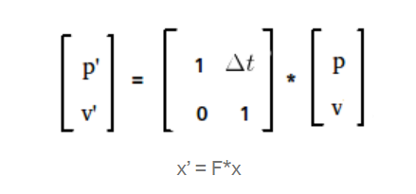
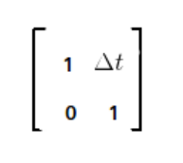
in matrix this can be shown as below:
then the F matrix will be given by:
B: Control input Matrix
It determines the change in the control input vector μ due to external force(longitudnal or latitudinal force) and internal force(gravity,friction etc.). In context to autonomous vehicle we cannot model the external forces as it varies from one region to region and internal forces as it varies from one model of the car to another. So mostly B.μ=0 .

Slide 12
v: Process Noise/Uncertainty
It is nothing but determines random noise that might be present in the system. It is added to make the prediction bit accurate.
Q: Process Noise/Motion Noise
It gives uncertainty in the object’s position when predicting location. The model assumes velocity is constant between time intervals, but in reality we know that an object’s velocity can change due to acceleration. The model includes this uncertainty via the process noise.

Slide 13
Update:
Step 1 : Find the difference between actual measured value and predicted value
Step 2 : Calculate Kalman Gain
Step 3: Based upon the result of Kalman Gain calculate new x and P .

Slide 14
Step 1:
y= z — H.x′
z: Actual measurement data
It is the actual data that is coming from the sensor.
H: State transition matrix
Same like F we use H to transform the state vector. But over here we use it to discard the information from the state vector that we do not require.
for example for the measurement taken by the radar we only need to focus on the position of the vehicle and need not to bother about veloctiy as radar is only good at determing the position of the velocity.

Slide 15
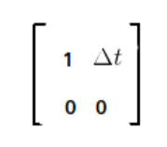
So in this case for our state vector that contains position and velocity of the vehicle the H matrix will be :
Step 2:
S= HP′Hᵀ + R
K= P′HᵀS⁻¹
R: Measurement Noise
Measurement noise refers to uncertainty in sensor measurements, It means that the devices itself has noise and are not 100% accurate therefore these noise measurement values are provided by the manufacturer of the device itself and need not to be changed.

Slide 16
S: Total Error
It is the sum of the prediction error plus the measurement error. As we have seen in the Kalman gain formula above we need to have the total error so here it is representer by S.
K: Kalman Gain
We calculate the Kalman Gain by the simple formula i have shown earlier . The only thing is that in matrix we cannot divide so here we are taking S⁻¹ .
Step 3:
x= x′ + K.y
P = (I- KH)P′
Finally we update are state vector and the covariance matrix and will move on to next prediction step to get the other values.

Slide 17
Problem with Kalman Filter
All these function used in Kalman Filter are linear as they do not include any angle prameter in there equation therefore we can directly feed these linear function to Gaussian distribution to get a Gaussian distribution mean and variance.
But in real life situation most of the problems are non-linear. Due to which we cannot directly feed this non-linear function to the Gaussian distribution as it will lead to non Gaussian distribution and we wont be able to apply Kalman Filter on it anymore.
This problem of non linearity in Kalman Filter was resolved using Extended Kalman Filter.

